Slide 1
Child components
Spencer Schneidenbach

Slide 2
What is a child component?
A child component is a component that exists within a component
I know, pretty stunning right?

Slide 3
Ok, well how do you make one?
Easy: you make a component!
Only a couple of steps to get it into a parent component

Slide 4
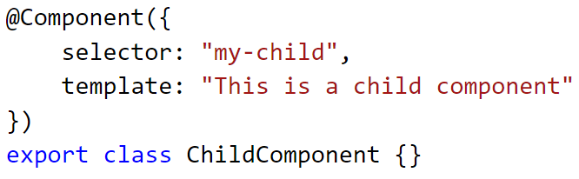
Step 1: Declare your component

Slide 5
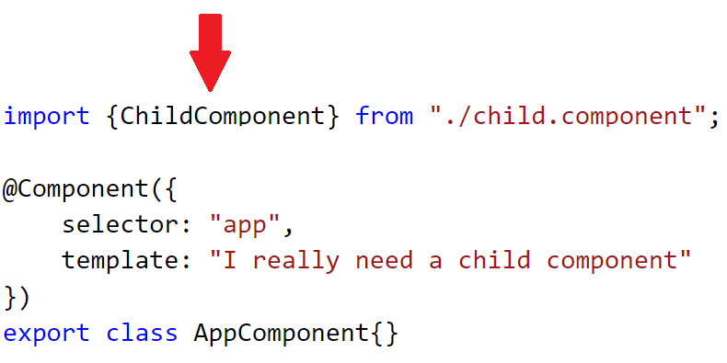
Step 2: Import it to your parent component

Slide 6
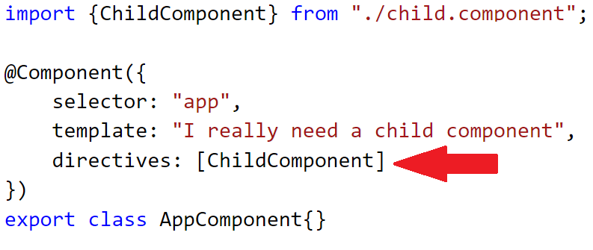
Step 3: Register it with your parent component
New @Component property: directives
You must register the component’s type with the parent component!

Slide 7
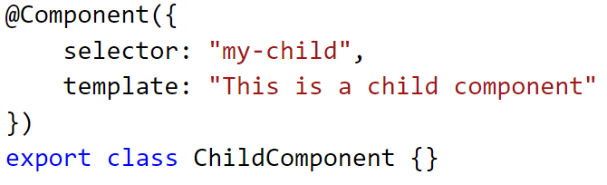
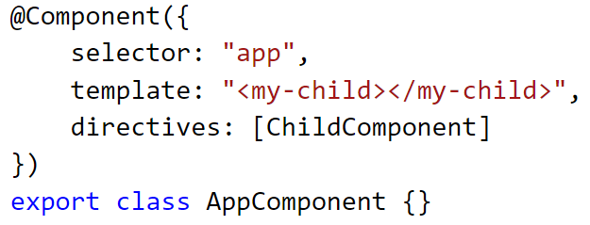
Step 4: Add child selector to markup

Slide 8
Walking the dog
Demo

Slide 9
You’re done!
Your child component is totally isolated – it can’t interact with your parent!
True encapsulation!
…
Ok, maybe we need to add some more stuff to make it useful in The Real World™

Slide 10
@Input properties
Means of binding data from the parent to the child
Requires two steps
Add property to child and decorate it with @Input
Bind the parent property to the child using [] syntax

Slide 11
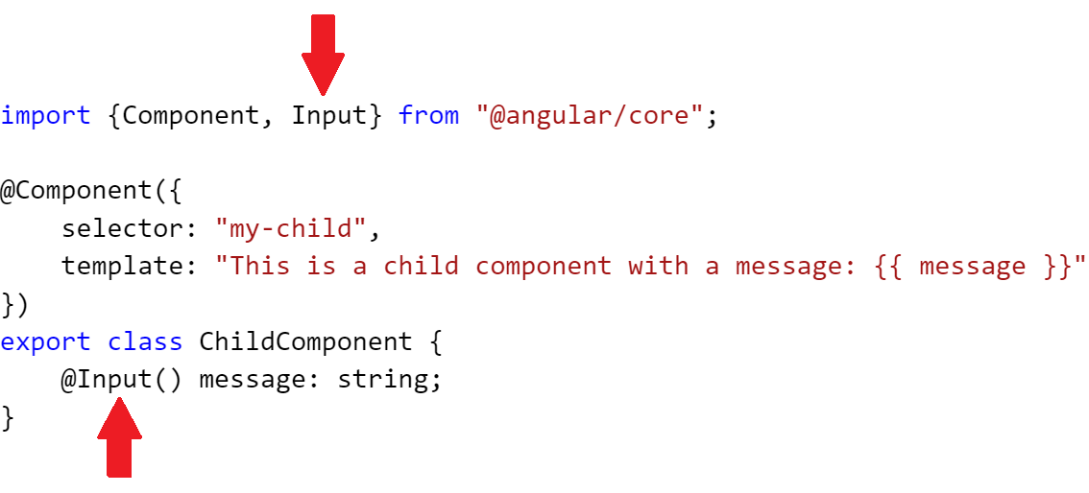
Step 1: Add the input property

Slide 12
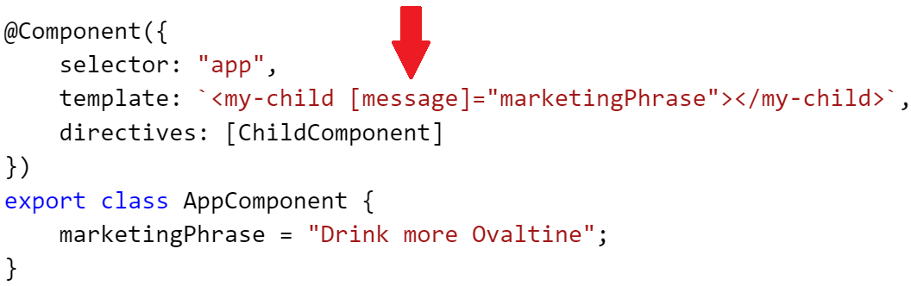
Step 2: Bind the parent property to that property

Slide 13
Keep walkin’
Switch back to the demo, Spencer

Slide 14
Event emitting and @Output
Parents can communicate with child components easily via input properties
How does the child communicate back up?
Simple: @Output properties and EventEmitter!
A little more to it than @Input properties, but very easy

Slide 15
Steps involved
Import the EventEmitter and Output types
Add property to child of type EventEmitter decorated with @Output
Write subscriber function in parent
Bind subscriber function to event using () syntax
Emit an event!

Slide 16
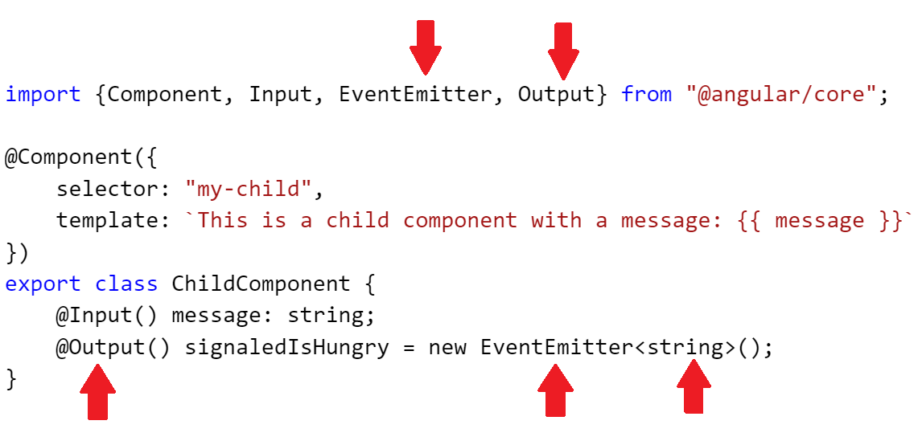
Steps 1 and 2

Slide 17
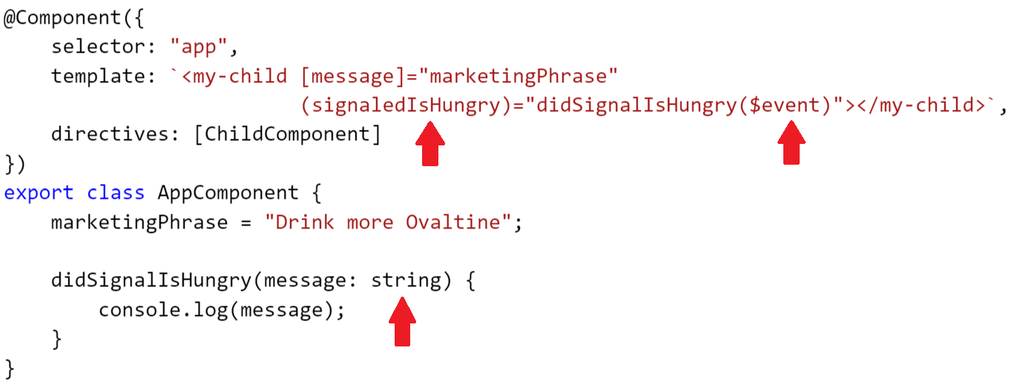
Steps 3 and 4

Slide 18
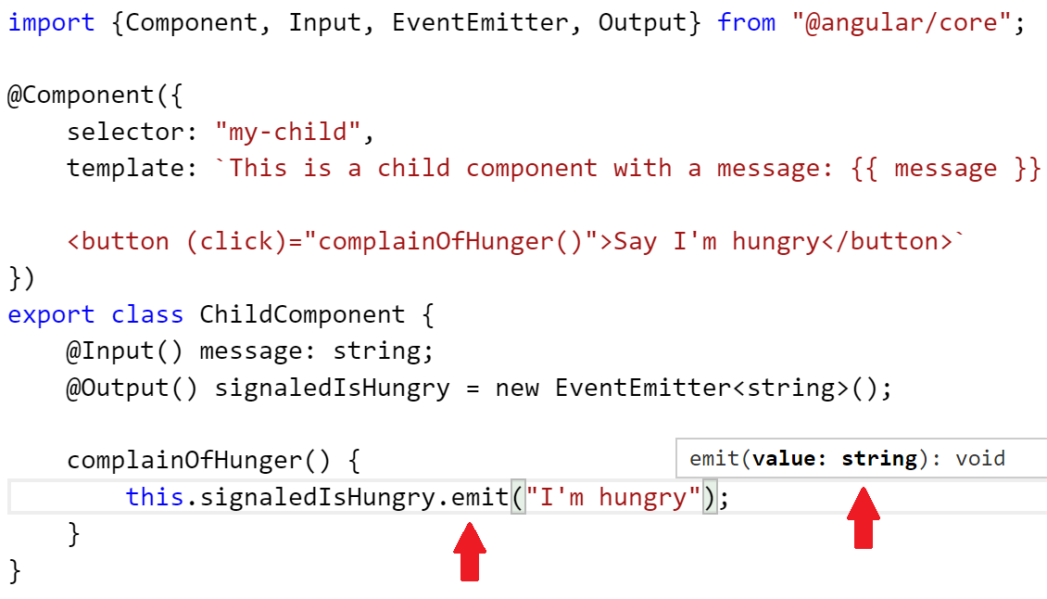
Step 5 – Emit your event

Slide 19
Keep walkin’
Switch back to the demo again, Spencer

